Slide 1



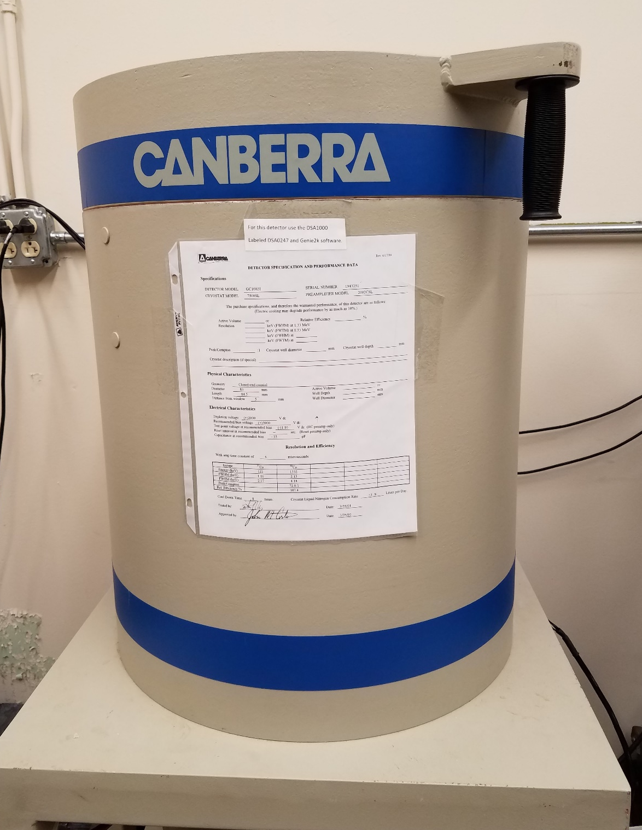
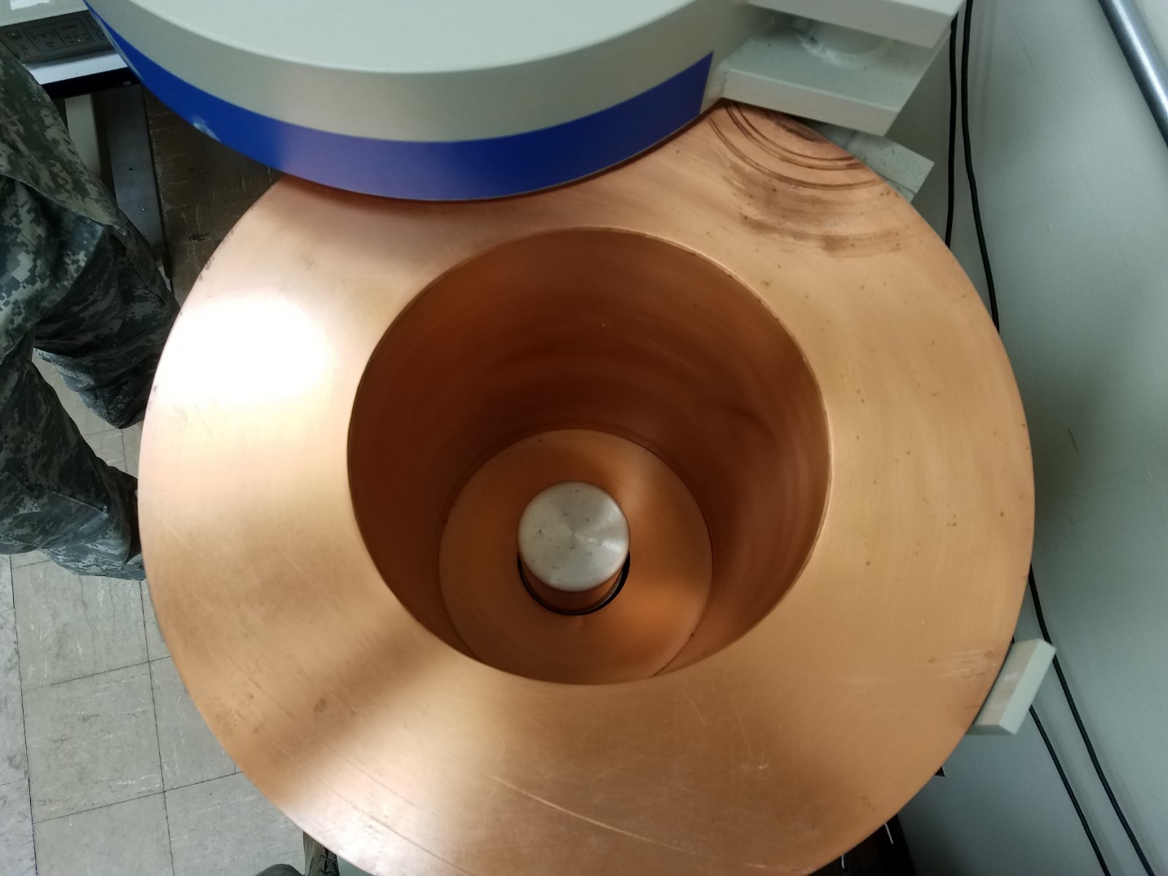
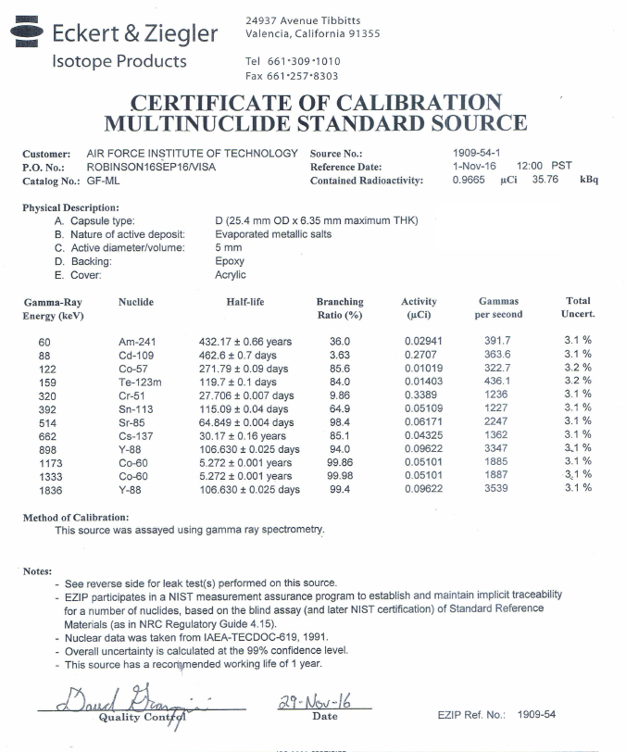
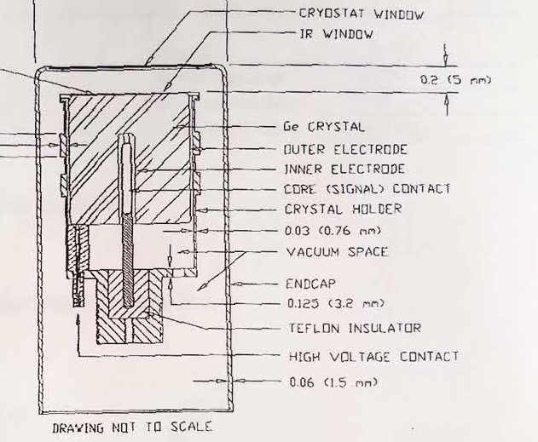
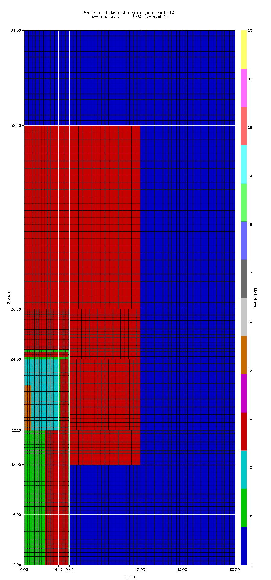
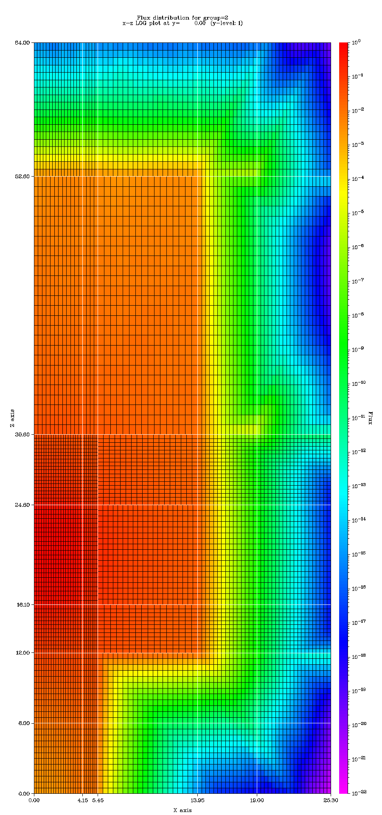
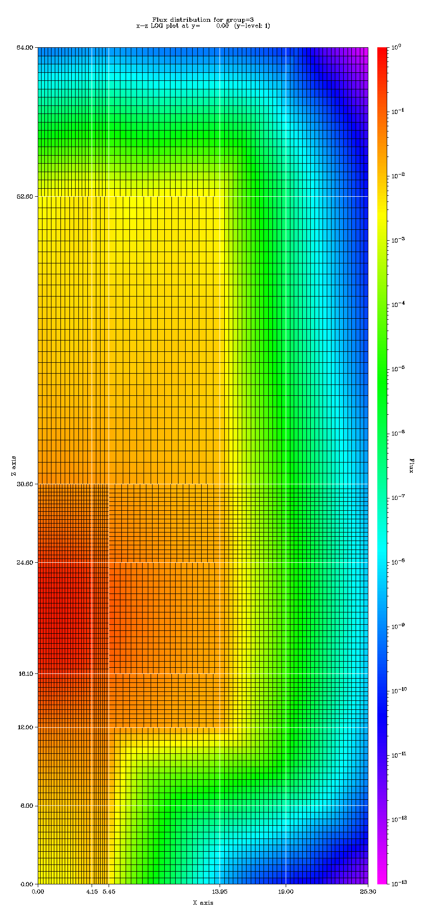
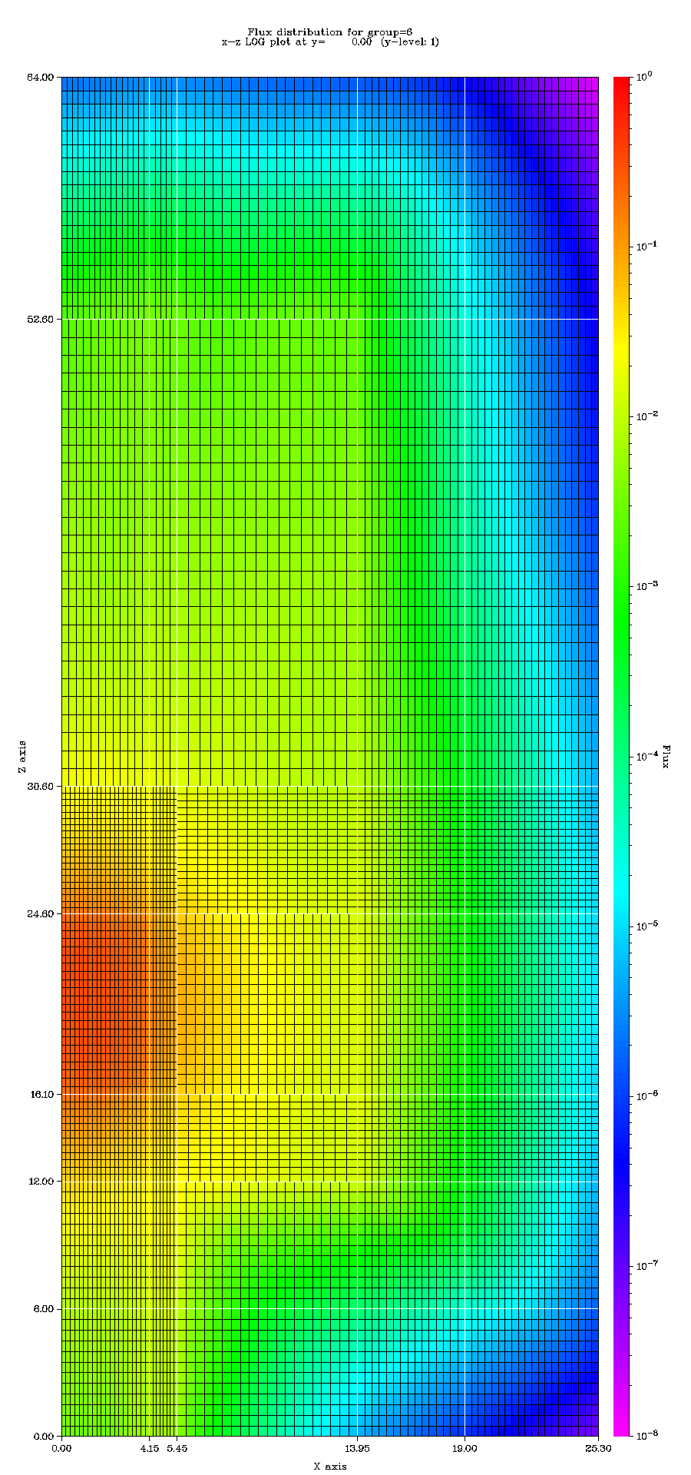
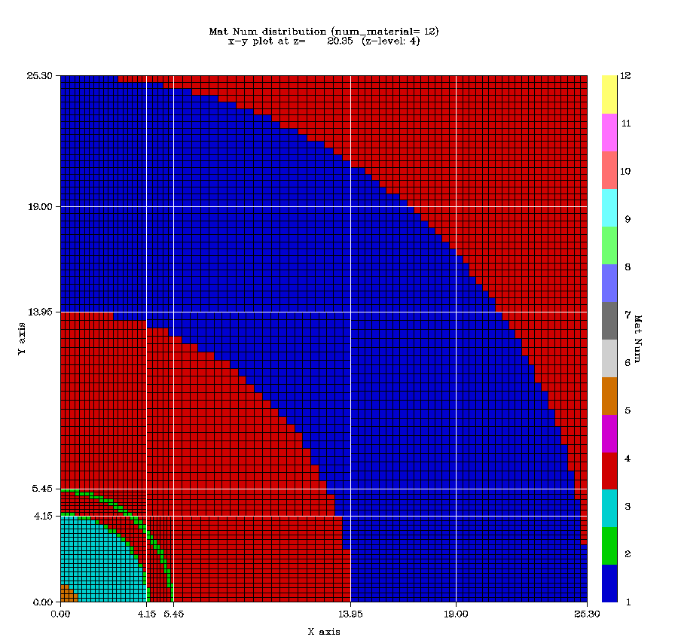
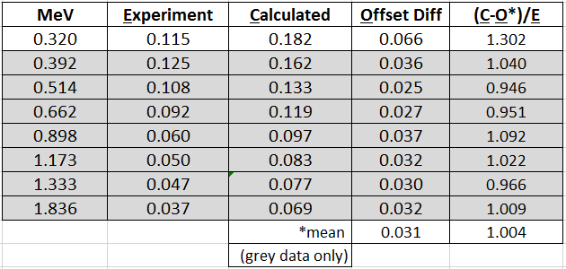
‘CARD’ – Characterization of Adjoint Response
for Ge Detectors
By G. Sjoden¹, J. Fee², B. O’Day², J. Petrosky²
CTBTO Science and Technology Conference 2017, Vienna, Austria
Topic 3: ADVANCES IN SENSORS, NETWORKS AND PROCESSING—
Design of Sensor Systems and Advanced Sensor Technologies
¹Air Force Technical Applications Center, Patrick Air Force Base, Florida
²Air Force Institute of Technology, Wright-Patterson Air Force Base, Ohio
INTRODUCTION
EXPERIMENT
Gamma ray spectroscopy an important tool in ensuring treaty verification
Need to understand / characterize HPGe detector efficiency, ε
ε calculated via deterministic adjoint radiation transport analysis
Adjoint transport methodology produces high fidelity map of detector efficiency ε for any photon energy
Adjoint mapping important to reveal subtle effects of source placement & sample geometry on detector ε
Impacts overall sensitivity of detector measurement, detectable quantities being measured, etc.
Test Data for
reference source
AFIT HPGe Detector
Adjoint Transport
ADJOINT EFFICIENCY MODEL
Forward Boltzmann Transport Eqn:
3-D Model Slice 0.375 MeV 0.625 MeV 1.375 MeV
Multigroup approx.:
Forward multi-group transport operator H used to derive adjoint operator H+ using adjoint identity for real functions; < > used for phase space integration:
Adjoint Identity:
Leads to adjoint eqn:
Adjoint function computed using ‘adjoint source’ aliased to detector cross section leads to adjoint ‘detector efficiency’.
Response R in detector is computed from either forward: or adjoint:
ε profiled with either many forward models (moving forward source to numerous new source locations, recomputing multigroup transport each time) OR run a SINGLE adjoint transport computation to map group adjoint ε values aliased to detector response cross section as function of position, energy, etc.
Adjoint transport yields global phase space gamma efficiency ε map for detector
Lead
Air
Ge Detector
C
Al
Computational (S20/P1) results depict a dramatic change in efficiency with position and energy, as expected
C/E Results
Conclusions
Comparisons made for 0 cm on top of detector
Detector measurement compared to computed adjoint efficiency data provided consistent results which revealed a ~3% efficiency loss for electronic conversion relative to modeled results (“offset” value). Future work will focus on enhancing model fidelity (Sn mesh, quadrature refinement), and comparison with additional measurement data for better ε corrections.
The views expressed in this poster are those of the authors and do not necessarily reflect the official policy or position of the Air Force, the U.S. Department of Defense, or the United States Government.
Correspondence author: glenn.sjoden@us.af.mil, +1 321 494 4402

